Slide 1

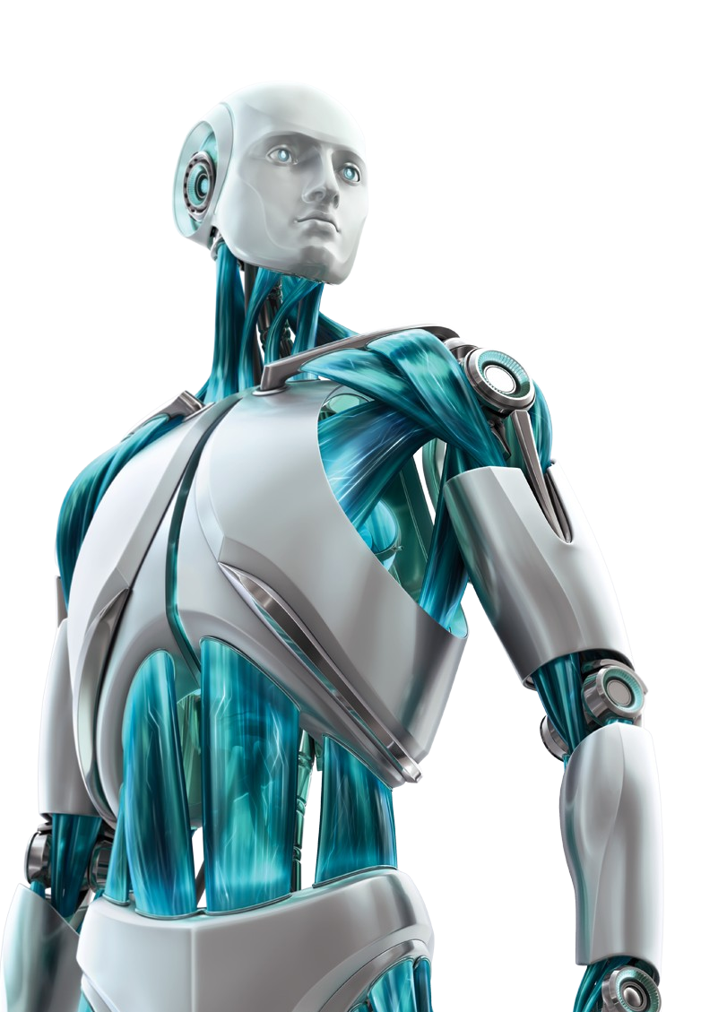


Slide 2

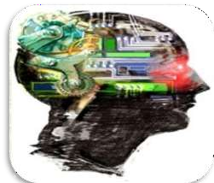
Intelligence : “The capacity to learn and solve problems.”
Artificial Intelligence : Artificial Intelligence (AI) is the simulation of
human intelligence by machines.
The ability to solve problems.
The ability to act rationally.
The ability to act like humans.
The central principles of Al include :
Reasoning, knowledge, planning, learning and communication.
Perception and the ability to move and manipulate objects.
It is the science and engineering of making intelligent machines, especially intelligent computer programs

Slide 3

Computers with the ability to mimic or duplicate the functions of the human brain.
Artificial Intelligence is the intelligence of machines and the branch of computer science which aims to create it.
"The branch of computer science that is concerned with the automation of intelligent behaviour" (Luger and Stubblefield. 1993).

Slide 4

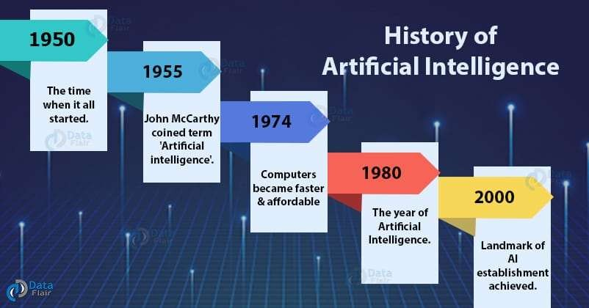
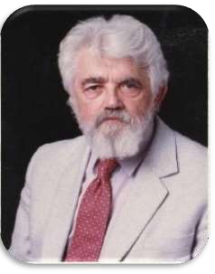

Slide 5
The Turing Test
1950 – Alan Turing devised a test for intelligence called the Imitation Game
Ask questions of two entities, receive answers from both
If you can’t tell which of the entities is human and which is a computer program, then you are fooled, and we should therefore consider the computer to be intelligent
Questions
Answers
Answers
Which is the person?
Which is the computer?

Slide 6
Solving the Turing Test: Eliza
Created by Joseph Weizenbaum
This system would act like a Rogerian psychoanalyst by holding a dialog with a person
the dialog would be consist of the doctor (Eliza) asking questions, the human responding, and the doctor using the response to ask another question
Weizenbaum wrote the program so that it would generate an English response/question based on a group of patterns
If the user sentence matched a pattern, this pattern would be used to generate the next sentence/question
A more recent, and much superior version is called A.L.I.C.E, see http://alicebot.blogspot.com/
click on “chat with A.L.I.C.E.”

Slide 7
Example Eliza Dialog
H: Men are all alike
E: In what way?
H: They’re always bugging us about something or another.
E: Can you be more specific?
H: Well, my boyfriend made me visit here.
E: Your boyfriend made you visit here?
H: He says I’m depressed much of the time.
E: I am sorry to hear you are depressed.
H: It’s true. I am unhappy.
E: Do you think coming here will help you not to be unhappy?
H: I need some help, that much seems certain.
E: What would it mean to you if you got some help?
H: Perhaps I could learn to get along with my mother.
E: Tell me more about your family

Slide 8
ALICE Demo
Jerry: my name is jerry.
ALICE: Hey jerry.
Jerry: do you know Turing?
ALICE: A brilliant and tragic figure in the history of computer science.
Jerry: who else do you know?
ALICE: Hugh Loebner, Robby Garner, and Steven Spielberg
Jerry: which film do you like?
ALICE: My favorite movie is Teknolust. Have you seen it?
Jerry: no.
ALICE: I would recommend you check it out.
Jerry: what is it about?
ALICE: Science fiction.
Jerry: do you remember my name?
ALICE: Your name is jerry, seeker.
Notice unlike Eliza, ALICE has a memory, can handle references
(have you seen it? no. I would recommend it.)

Slide 9
How Useful is the Turing Test?
With Eliza or Alice like rules, we can eventually solve the Turing Test – it just takes writing enough rules
Does the system understand what it is responding to?
No, neither Eliza nor Alice understand the text, its just that Alice has better, more in depth and wider ranging rules
However, we could build a representation that models some real-world domain and knowledge base
The system can fill in information from the conversation
this is sort of like a database, or an object with data attributes to be filled in
we can use a variety of AI representations like scripts, frames, semantic networks
Questions can be responded to by looking up the stored data
In this way, the system is responding, not based merely on “canned” knowledge, but on knowledge that it has “learned”
Does this imply that the system knows what it is discussing?
What does it mean to know something?

Slide 10

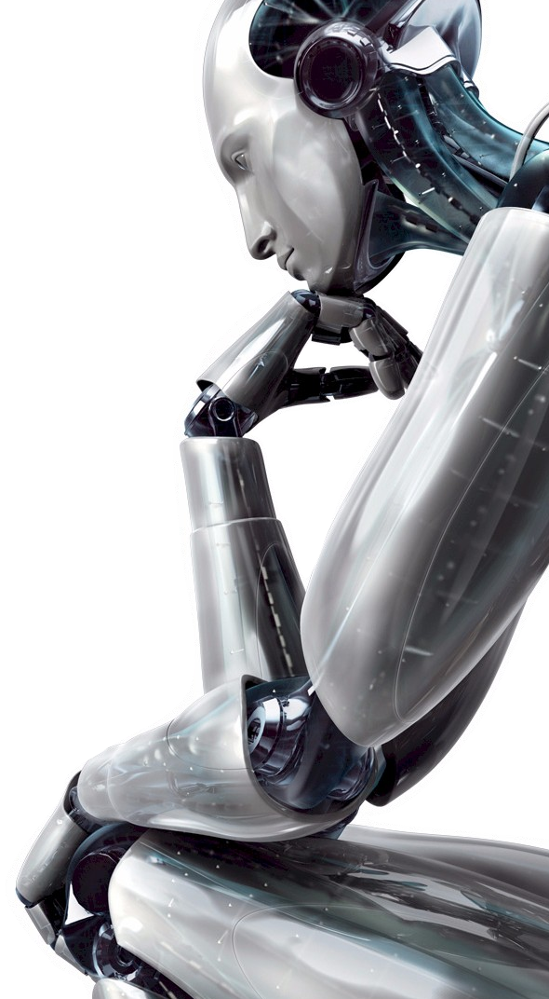


It’s a composition of abilities like:

Slide 11
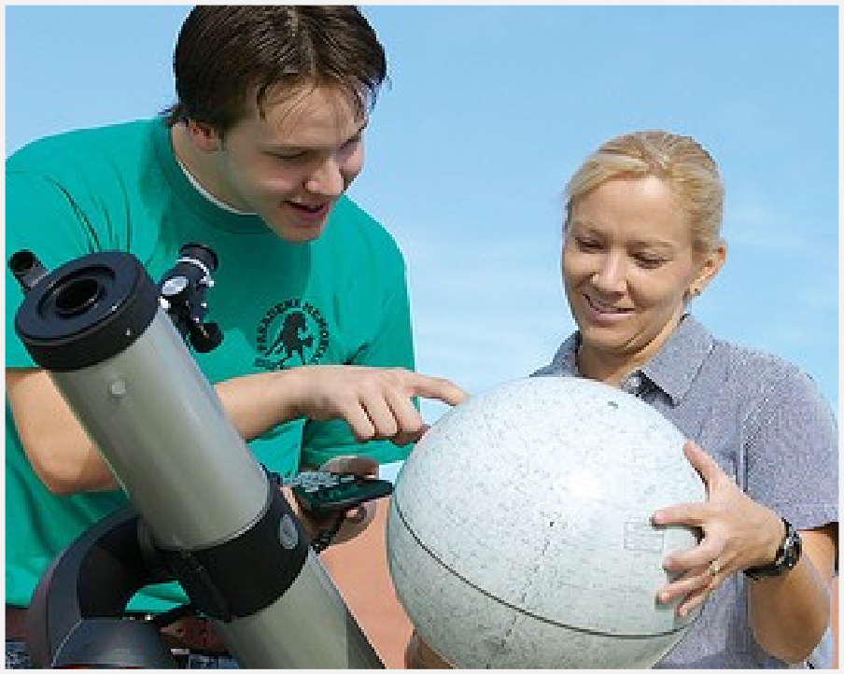
It’s a composition of abilities like:
LEARNING

Slide 12
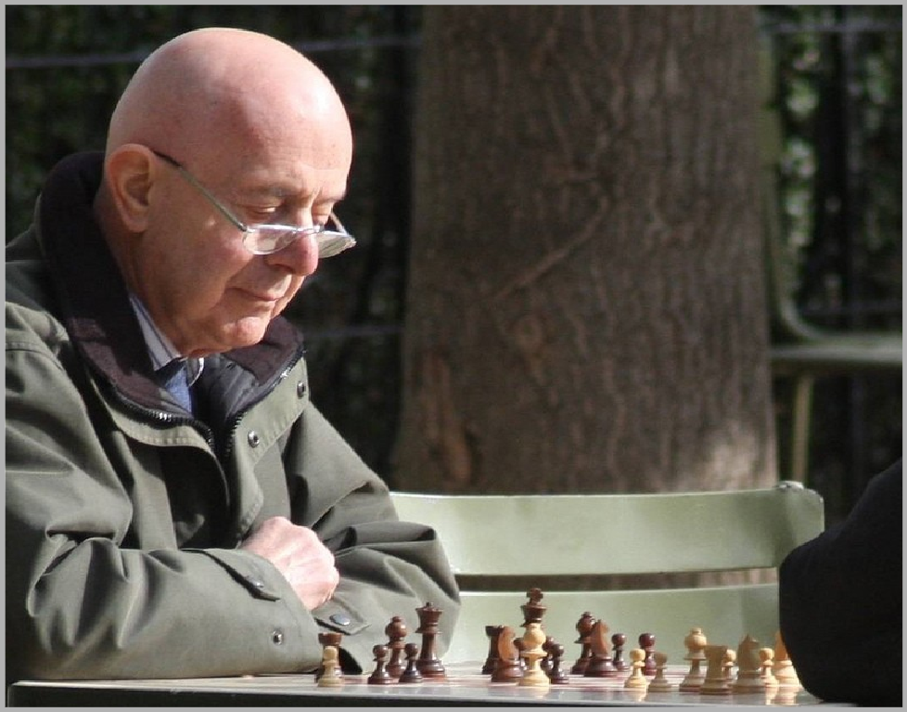
It’s a composition of abilities like:
REASONING

Slide 13
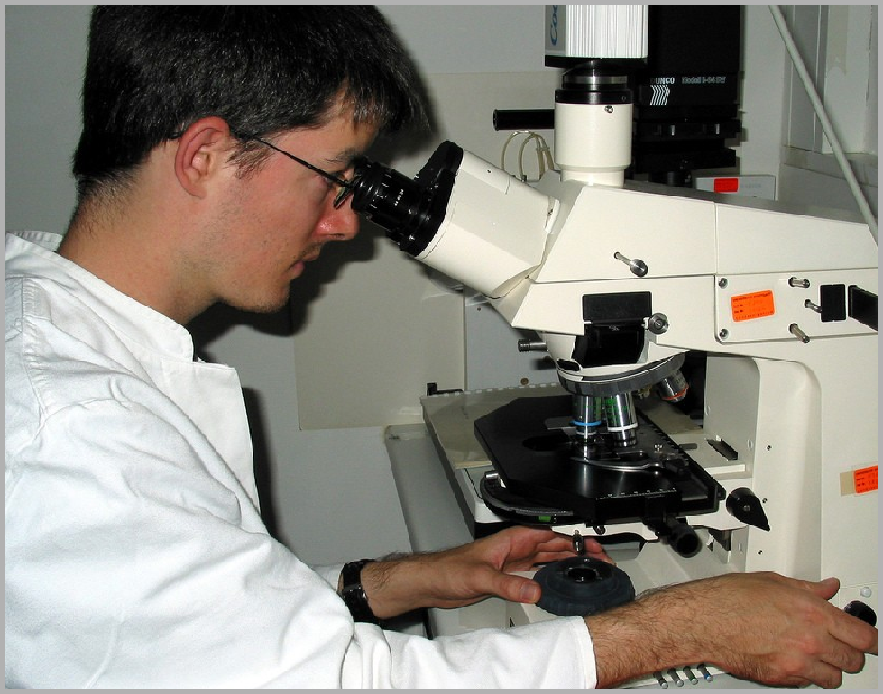
It’s a composition of abilities like:
PERCEIVING

Slide 14
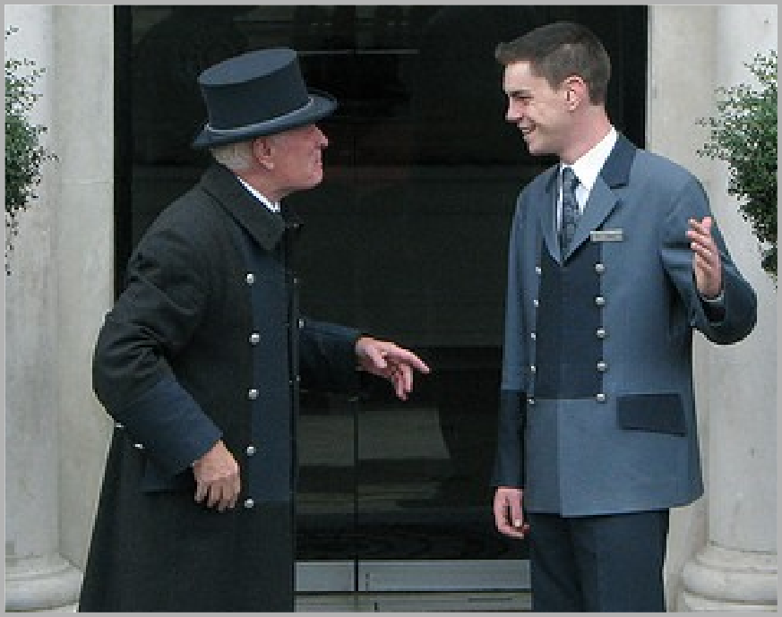
It’s a composition of abilities like:
UNDERSTANDING OF LANGAUGE

Slide 15
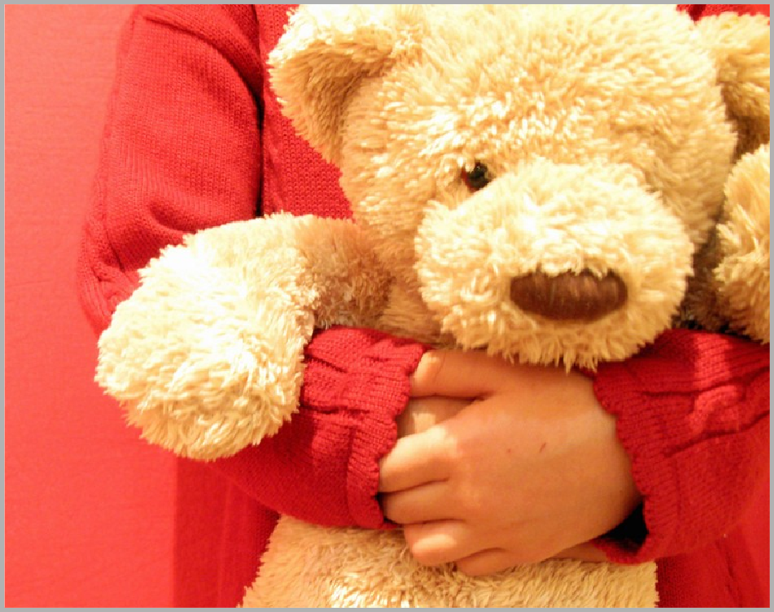
It’s a composition of abilities like:
FEELING

Slide 16
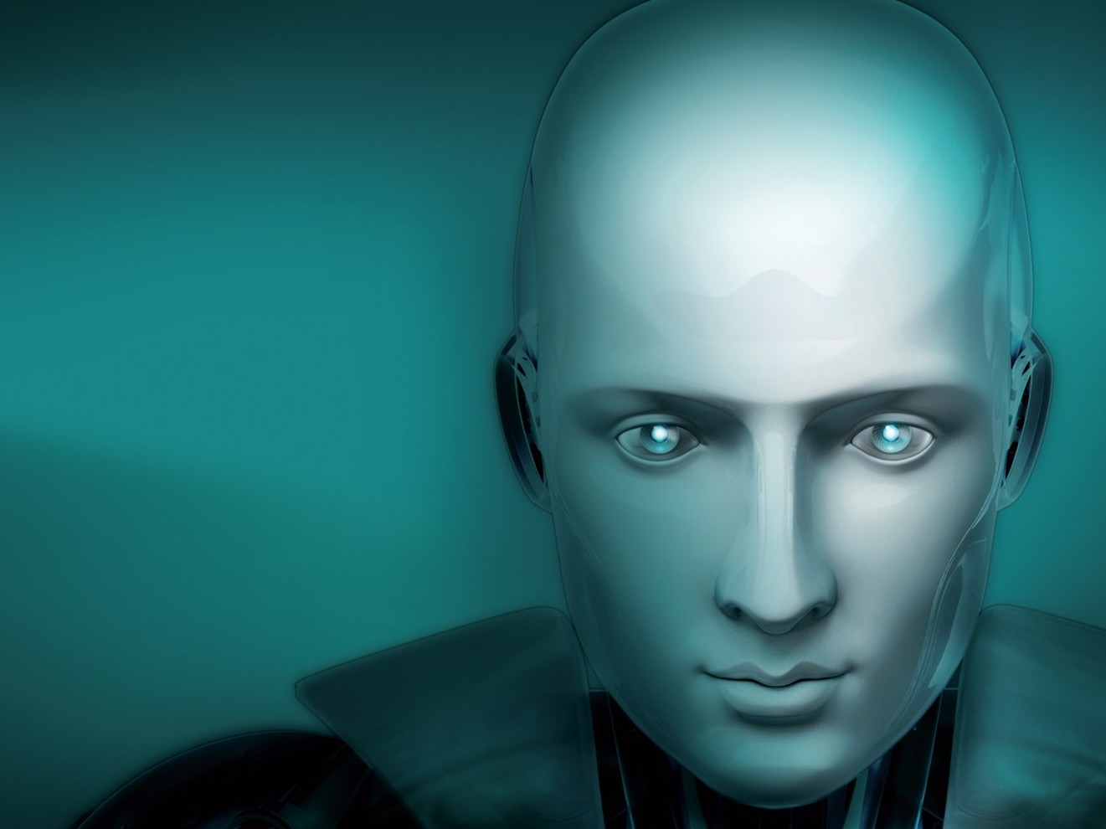


Artificial intelligence is the science and engineering of making intelligent machines.

Slide 17

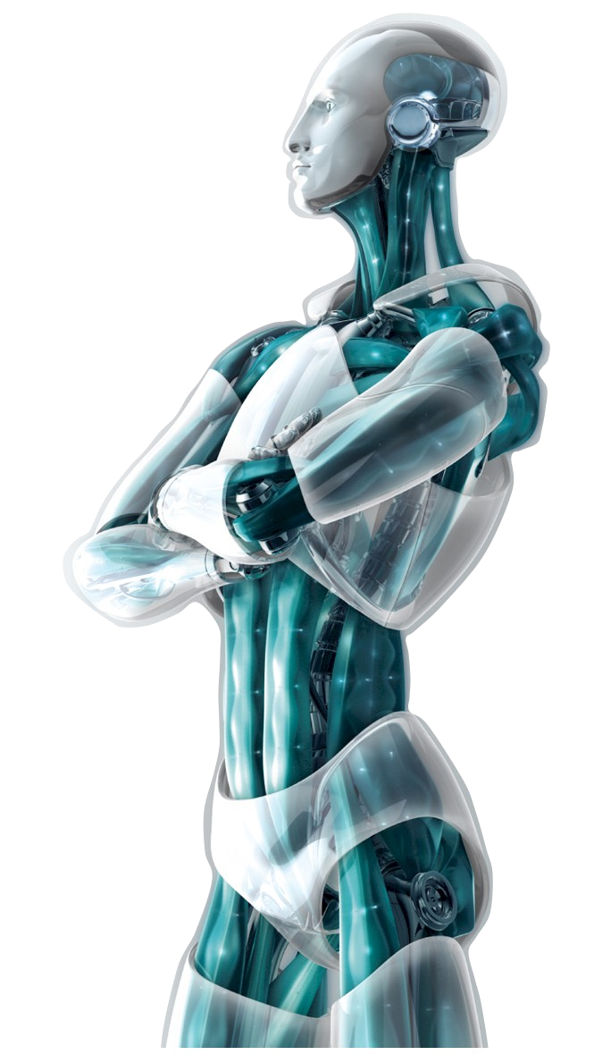



Slide 18
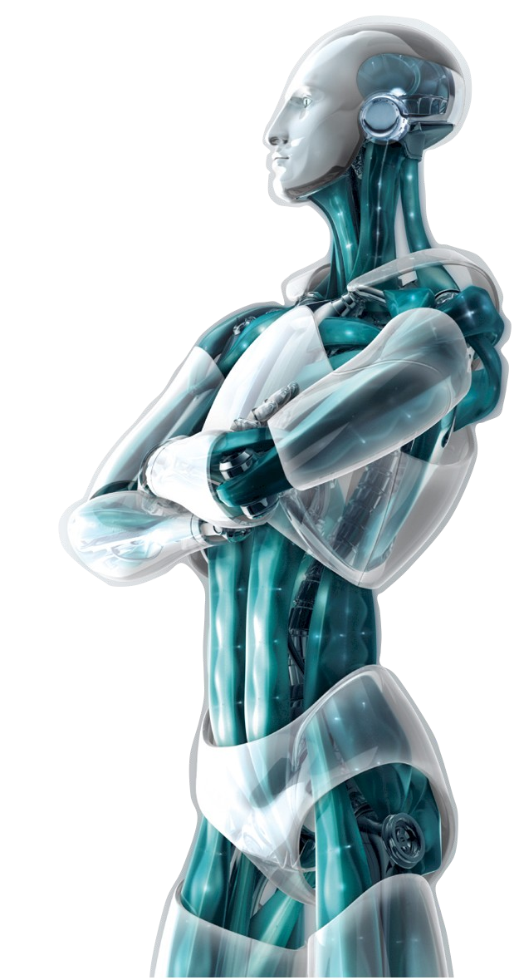
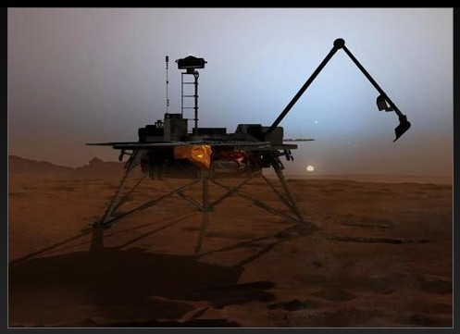
Space Program
The Mars Lander:
Being able to Navigate on the Red Planet, the robot arm has been digging in the Martian Soil & Ice for 2.5 hours a day.

Slide 19
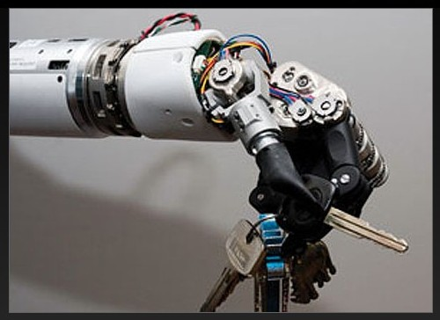
Prosthetic Limbs
Mind-controlled prosthetic arm : The user controls the arm through existing nerves and it is sensitive enough to pick up even a piece of paper!

Slide 20
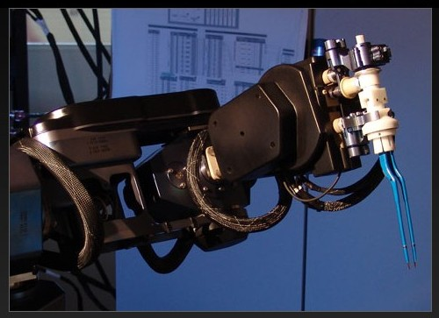
Surgical System
Neuroarm :
It is a surgical robotic system, that can do delicate brain surgery, also enabling physicians to manipulate tools at microscopic levels.

Slide 21
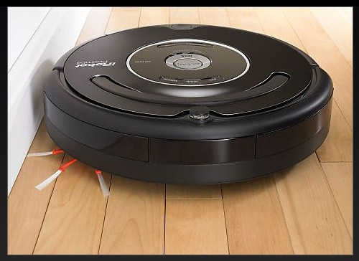
All-in-one Floor Cleaner
iRobot :
It performs the duties of a vacuum cleaner, floor washer and gutter cleaner.

Slide 22
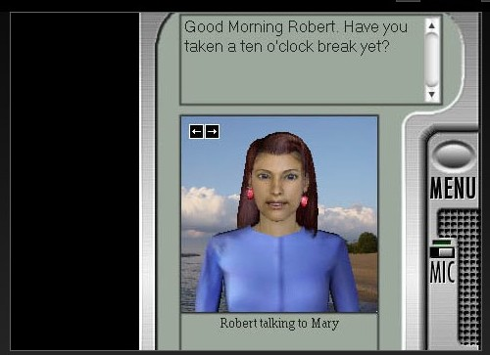
Your Digital Secretary
Ultra Hal Assistant :
A digital secretary that uses AI to understand spoken English commands and to learn over time..

Slide 23
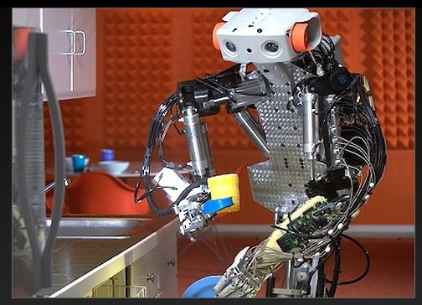
Walk Likea Man
Dexter :
Having flexible joints, driven by air cylinders, it can walk, run and even jump.

Slide 24


Slide 25


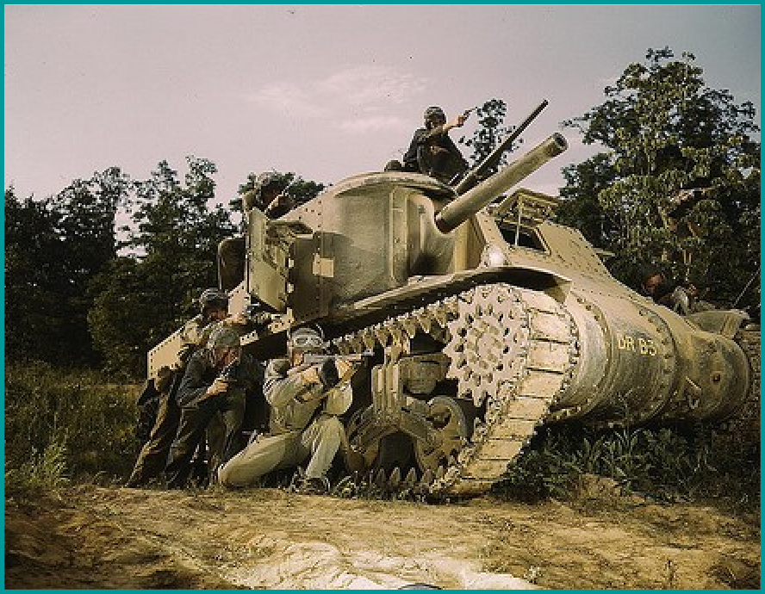
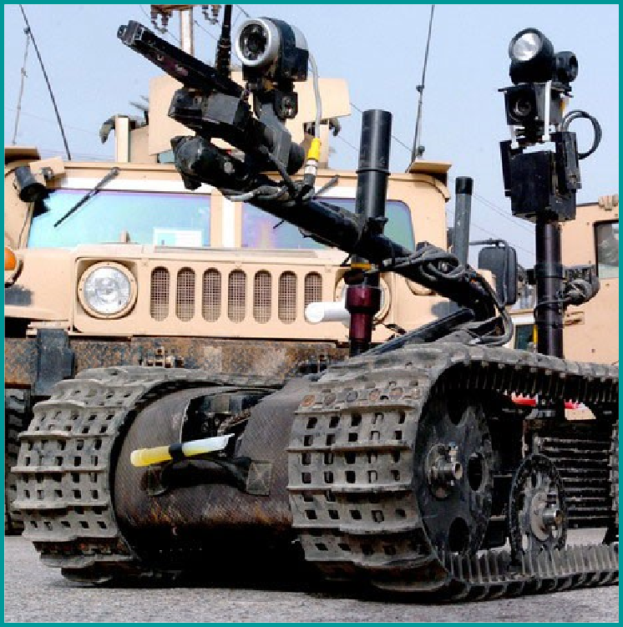
Military Technology
Aiming, Defending, and Moving are done simultaneously by us.
But with AI technology, the tank will be able to auto-detect enemy units and take action.

Slide 26
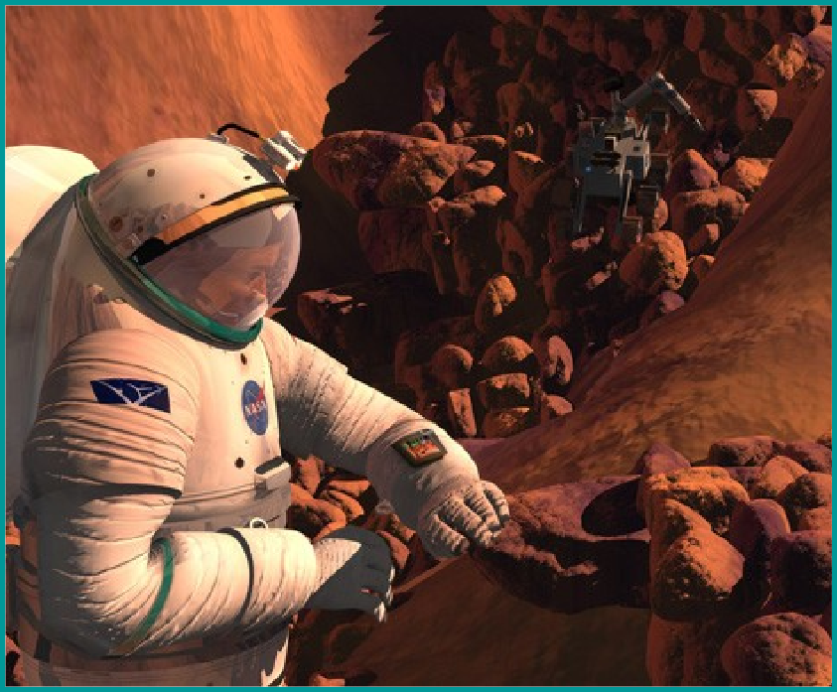
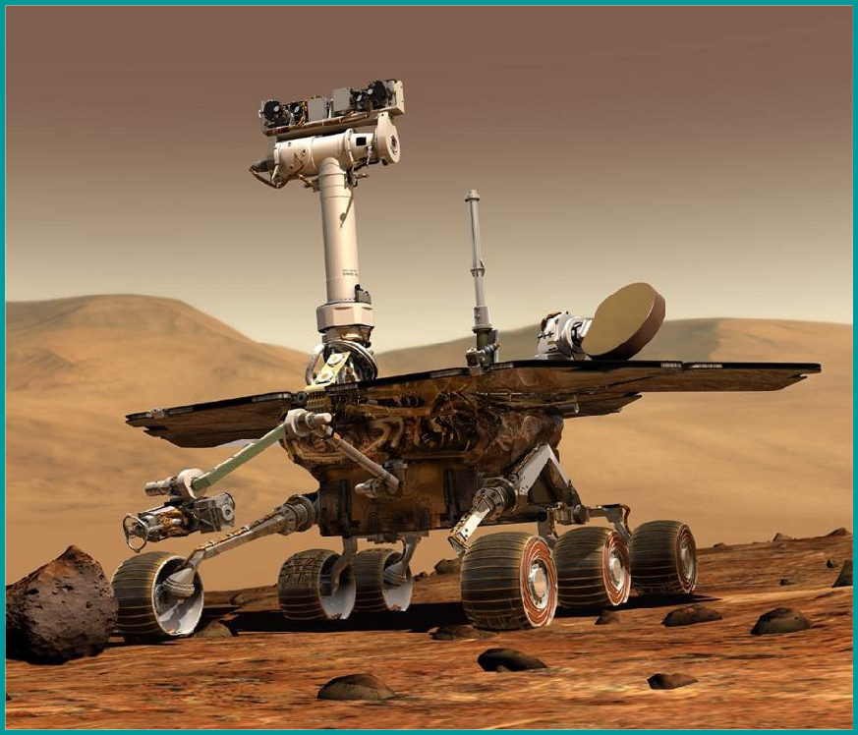
Space Exploration:
Humans need provisions for: Water, Recycling, Food, Space Radiation and Psychological Issues of confinement.
None of these issues concern a robot.

Slide 27

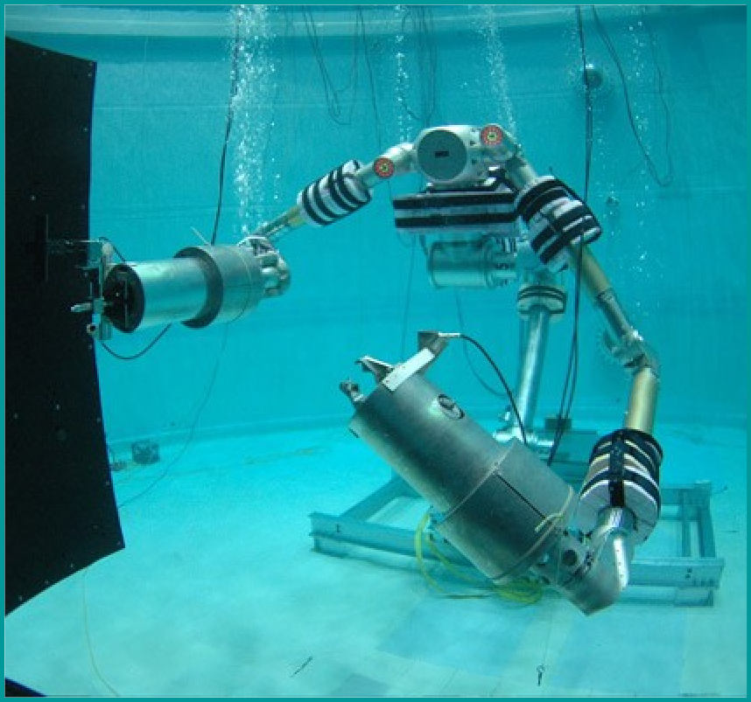
Underwater Mining
It is not possible to have Mining Staff
on site at such depths.

Slide 28
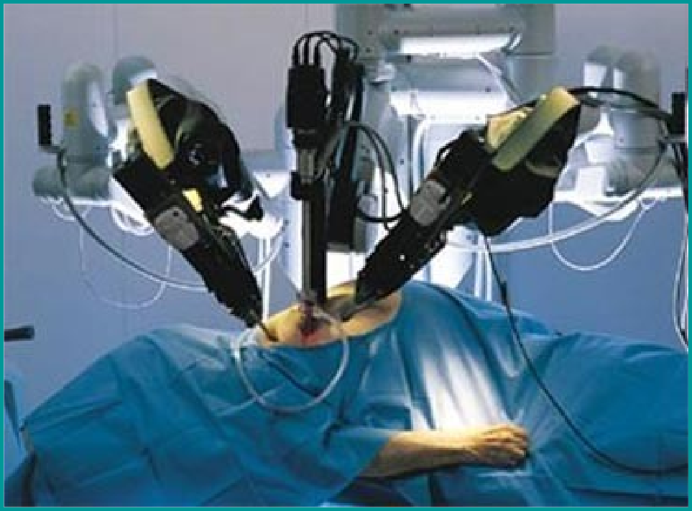
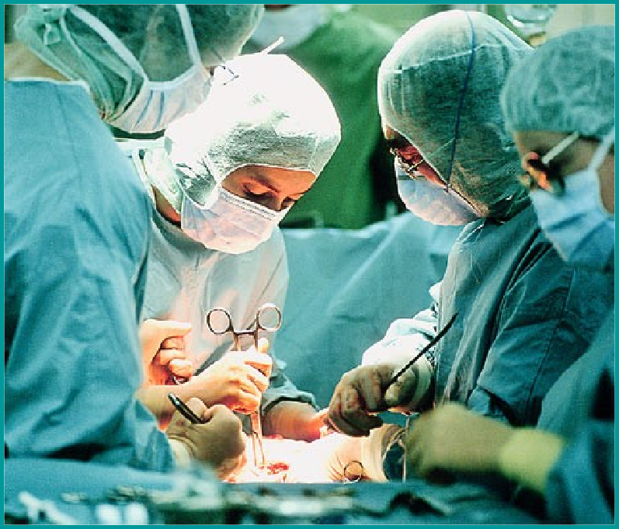
Medical Research
AI Technology can perform delicate operations more precisely and efficiently..

Slide 29
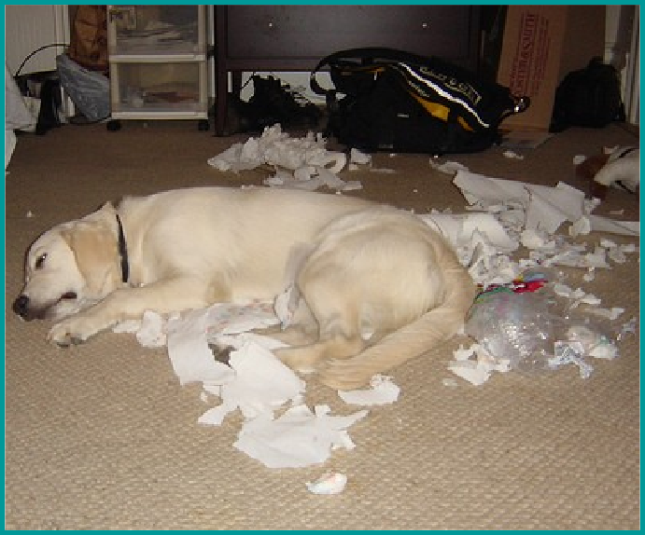
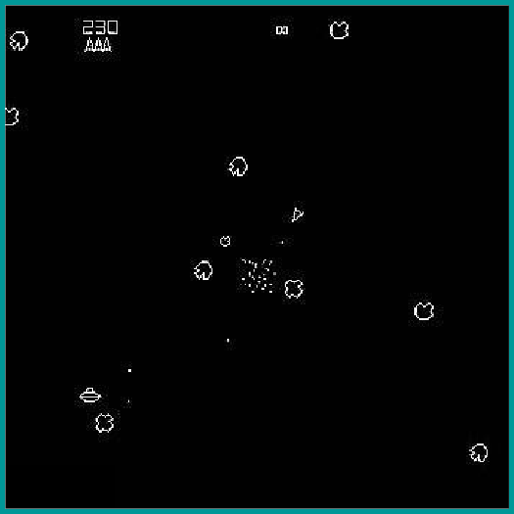
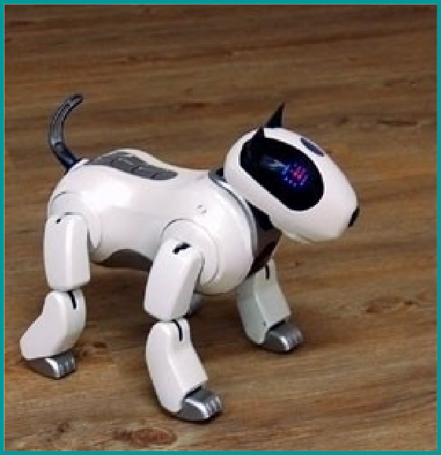

Entertainment
Dog
Asteroids
Robo Dog
X Men: The Game

Slide 30
 Advantages :
 Disadvantages :
More powerful and more useful computers.
New and improved interfaces.
Solving new problems.
Better handling of information.
Relieves information overload.
Conversion of information into knowledge.
Increased costs
Difficulty with software development - slow and expensive
Few experienced
programmers
Few practical products have reached the market as yet.

Slide 31

Looking at the features and its wide application we may definitely stick to artificial intelligence. Seeing at the development of Al is it that the future world is becoming artificial.
Biological intelligence is fixed, because it is an old, mature paradigm but the new paradigm of non-biological computation and intelligence is growing exponentially.
The memory capacity of the human brain is probably of the order often thousand million binary digits. But most of this is probably used in remembering visual impressions, and other comparatively wasteful ways.
Hence we can say that as natural intelligence is limited and volatile too
world may now depend upon computers for smooth working.

Slide 32
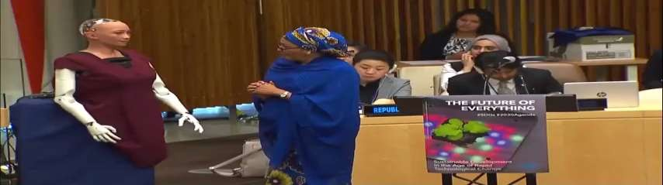
Sophia is a social humanoid robot developed by Hong Kong based company Hanson Robotics.
Sophia was activated on April 19,2015.
She made her first public appearance at South by Southwest Festival in mid-March 2016 in United States.
In October 2017 Sophia became a Saudi Arabian citizen, the first robot to receive citizenship in any country.

Slide 33
Since Al is applicable in almost all fields, they become the needs of our life. It is the reason behind the explosive growth of AI.
The growth can be divided into two parts based on the application area and what purpose they serve, they are as follows:
Growth in positive sense (useful to society)
Growth in negative sense (harmful to society)

Slide 34

Till now we have discussed in brief about Artificial Intelligence.
We have discussed some of its principles, its applications, its achievements etc.
The ultimate goal of institutions and scientists working on Al is to solve majority of the problems or to achieve the tasks which we humans directly can't accomplish.
It is for sure that development in this field of computer science will change the complete scenario of the world. Now it is the responsibility of creamy layer of engineers to develop this field.

